Slide 1
Fresh Grads – Group Project
Online Pizza Ordering application

Slide 2
Problem Statement
To Create an Application for online Pizza Order System
Customer should be able to view the list of pizzas and can order pizza based on his/her desire by applying coupons.
Customer should be able to see the order history and can update, cancel orders.
Admin should be able to perform below operations:
1. Pizza Management
2.Order Management
3.Customer Management
4.Coupns Management

Slide 3
Road Map
Application will be developed in following Sprints –
Core Java +JPA with Hibernate
Spring Boot + Rest Controller + JPA with Hibernate
Angular for UI design (Front End) + Integration with previous Sprint

Slide 4
Plan
Design
Generate the skeleton as per class design provided
TDD approach
Identify test cases for each module
Write Failing Test cases
Convert the Test Cases in GREEN
Implement the case study in incremental manner

Slide 5
Modules
Login,Registration Module
Customer Module
Pizza Order Module
Pizza Management Module
Coupons Module

Slide 6
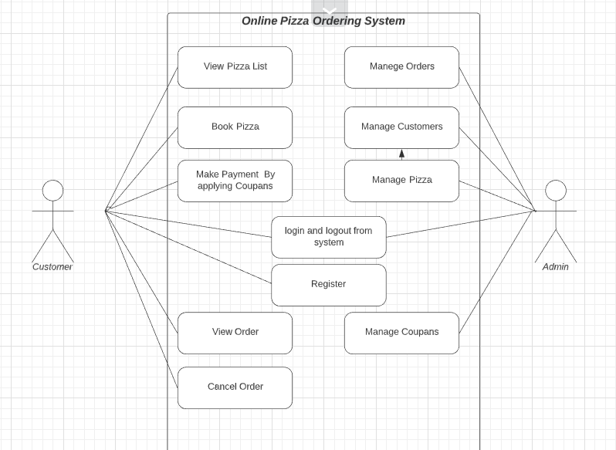
Use Case Diagram:

Slide 7
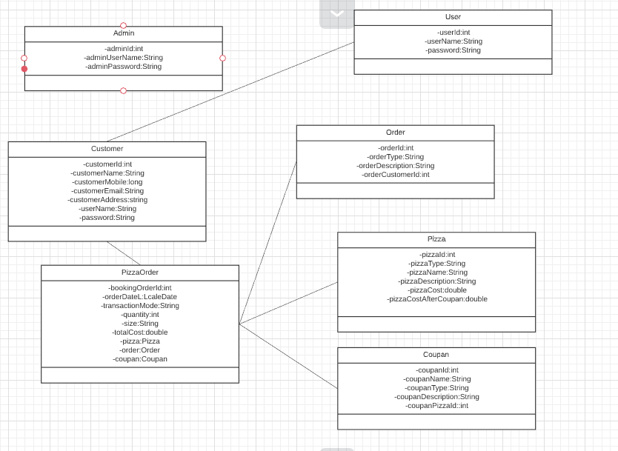
Class Design
POJO Classes:

Slide 8
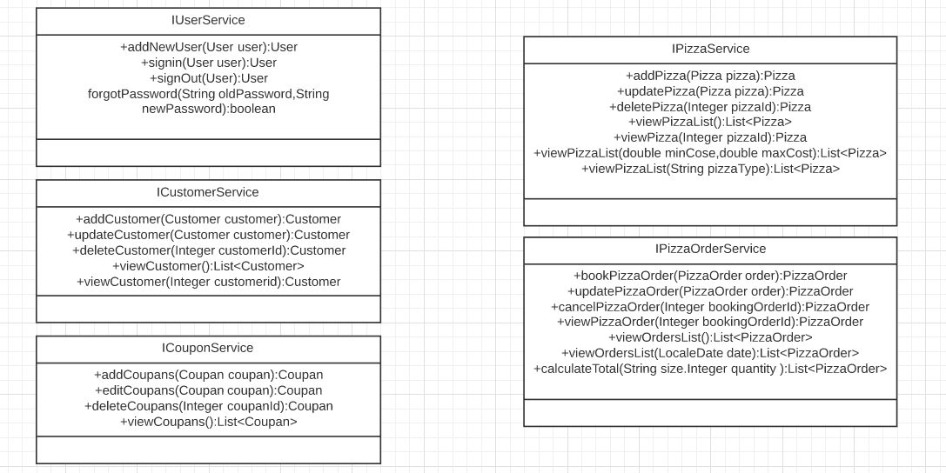
Class Design
Service Interface:

Slide 9
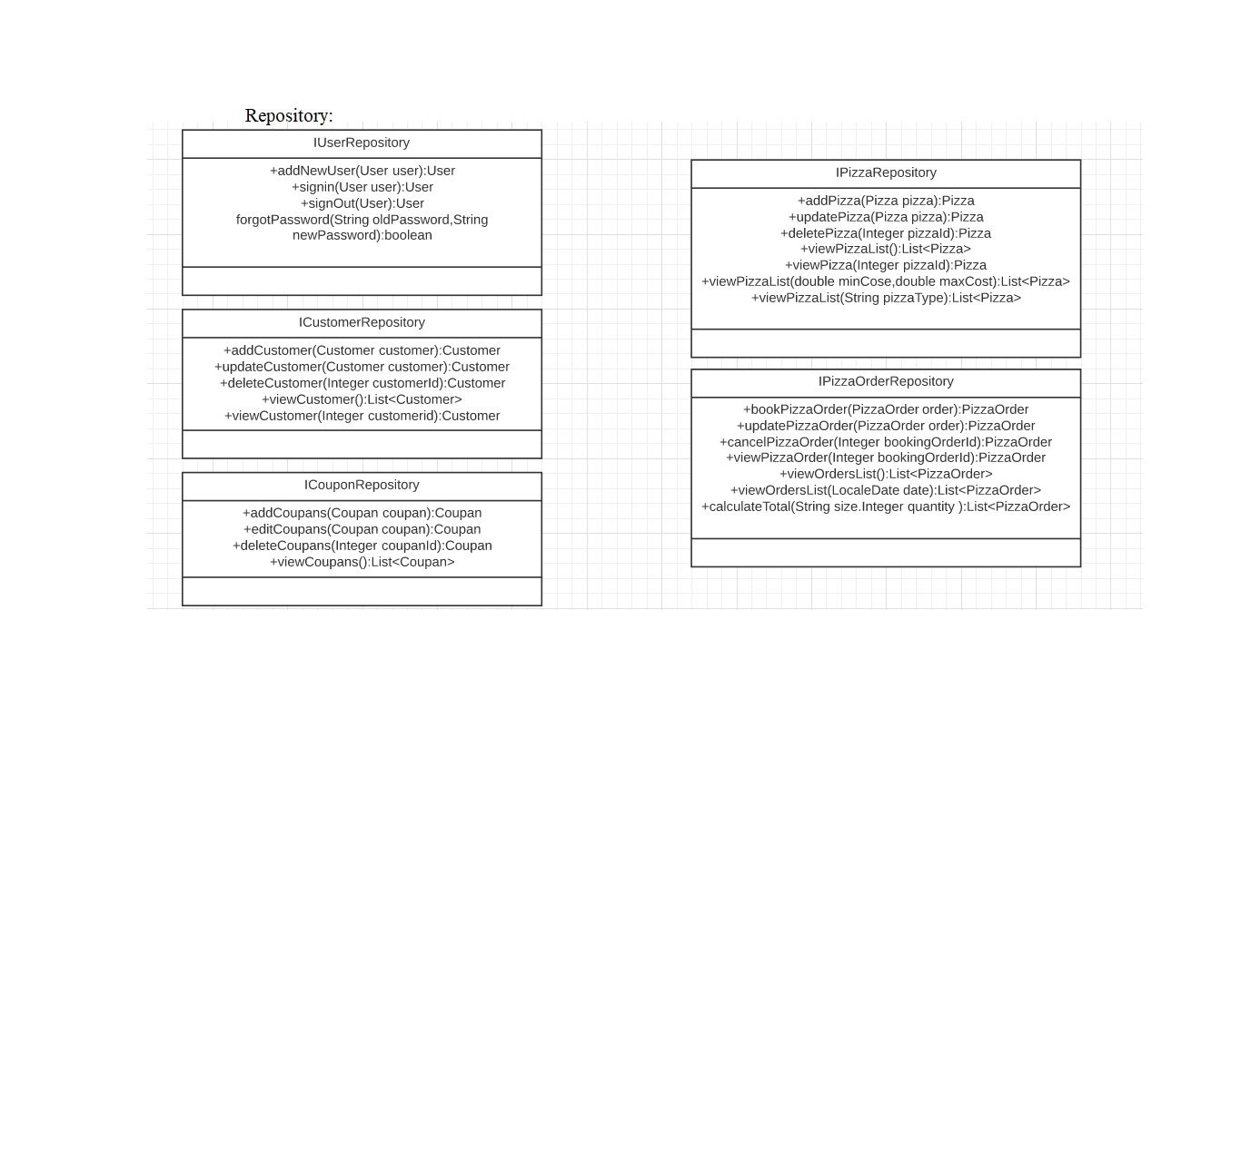
Class Design
Repository:

Slide 10




Questions

